Slide 1
Lab meeting
尹纯友
2020/12/30

Slide 2
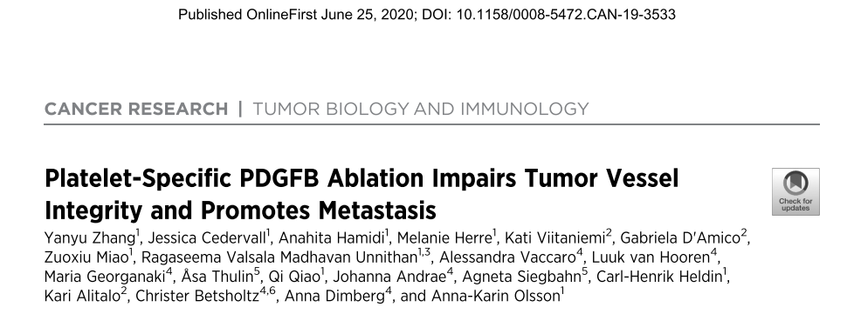

Slide 3
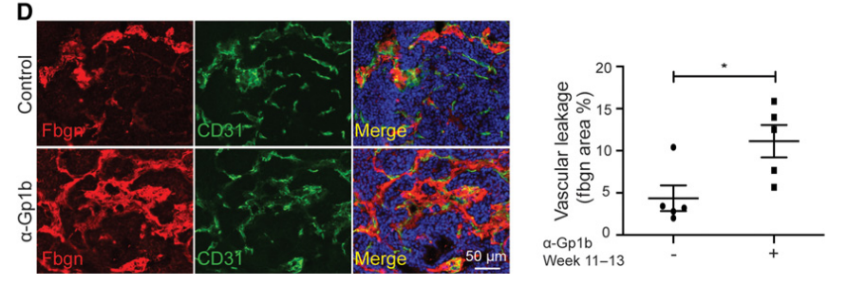
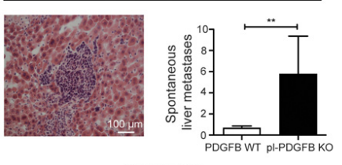
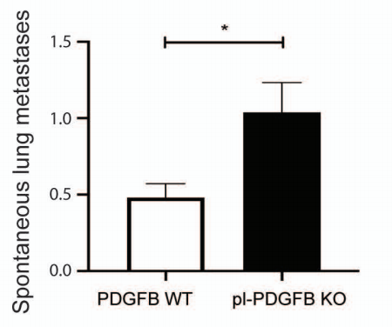
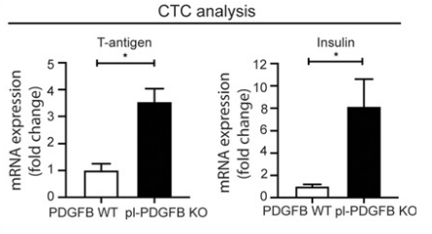
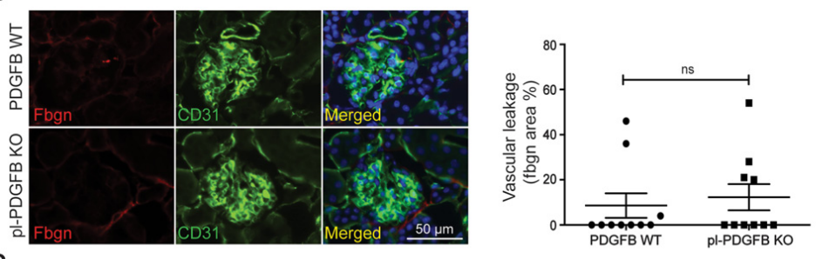
How to quantify the depletion effects?
Vascular leakage
Number of circulating tumor cells
Metastasis to liver or lung

Slide 4
肿瘤对侧肾 肾内肿瘤

Slide 5
plans
Pdgfb Knockout or Cx3cr1^{CreER} ｘiDTR depletion effects:
Tumor volume
Vascular density
Intra tumor CD8+ T cell
Vascular leakage
Circulating tumors
Metastatsis
Pdgfb mediates tumorgenic effects
纯化 SM-MФ，检测 Pdgfb 在静息和肿瘤内的表达变化

Slide 6
kidney macrophage after LPS challenge

Slide 7
Control 48h 72h

Slide 9
Urine total protein after LPS challenge

Slide 10
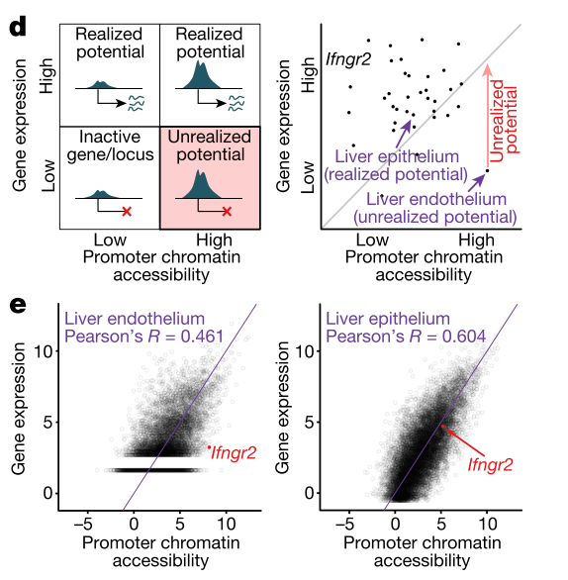
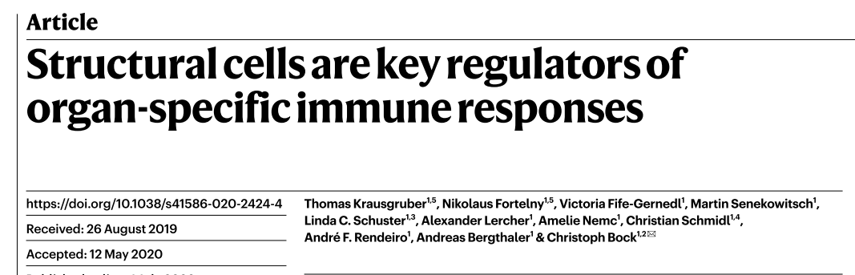

Slide 11
plans
where the macrophage comes from?
migrate from medulla
derive from blood monocyte
LPS 后尿蛋白的变化
去掉 macrophage 后打 LPS 尿蛋白的变化

